Slide 1
PRESIDENCY UNIVERISTY, BENGALURU, School of Engineering
Computer Organization and Architecture
CSE 2009
Module-2: Part B- Memory Unit

Slide 2
The Memory System
WKT, memory is the integral part of any computer system
It is also known that, execution speed of any program mainly depends on how data & instructions are transferred between the processor and the memory.
Developers/Designers should have in-depth knowledge in order to develop memory structure cleverly so that the size & speed should be improved by keeping its cost reasonable.
Memory
Primary Memory Secondary memory
RAM ROM Magnetic Storage optical storage

Slide 3
Some basic concepts
Maximum size of the memory of a computer is determined by the number of address lines of the processor bus.
For ex, computer having 16 address lines are capable of addressing upto 2¹⁶ = 64K memory locations.
So, in general, if there are K bit address lines, then there are 2^{K} memory locations
If the memory is byte addressable, each location of memory can store 8 bit of information.
So, memory capacity L=2^{K} locations * 8 bits/location= 2^{K} bytes

Slide 4
Addressing & Capacity
If a processor has K address lines, it can access 2^K locations.
Example: 16 address lines → 2¹⁶ = 64K memory locations.
If byte-addressable, each location = 8 bits.
Hence, total capacity L = 2^K × 8 bits = 2^K bytes.
Processor–Memory Interface
MAR (Memory Address Register): Holds the address of the memory location to be accessed.
MDR (Memory Data Register): Holds data being transferred to/from memory.
Control lines (R/ W, MFC): Indicate whether it’s a read or write and whether memory is ready.

Slide 5
Some basic concepts
In order to transfer data between memory & processor, we need some interface circuitry & is as shown in the fig.
Data transfer between memory & processor is done through MAR & MDR
Processor
k
-bit
Memory
address bus
MAR
n
-bit
data bus
Up to 2
k
MDR
addressable
locations
Word length =
n
bits
Control lines
R
/
W
( , MFC, etc.)

Slide 6
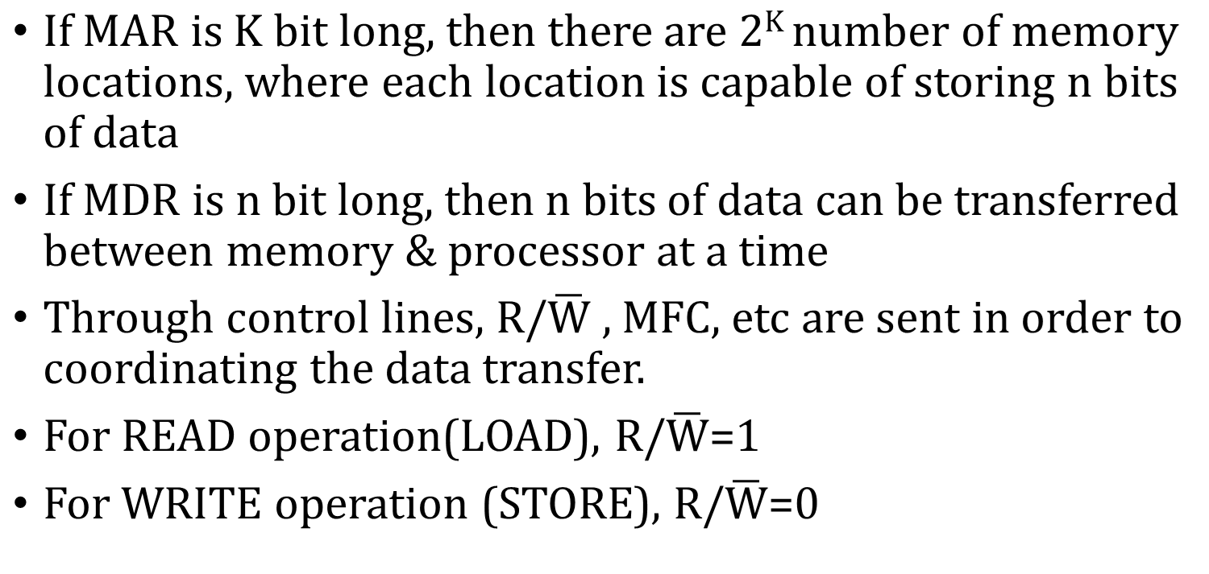

Slide 7
Some basic concepts(Contd.,)
Measures for the speed of a memory:
  memory access time. Memory Access Time is the total time taken by the computer to locate a memory location and retrieve the required data (read) or store data (write) from it.
  memory cycle time: Minimum time between two memory accesses.
An important design issue is to provide a computer system with as large and fast a memory as possible, within a given cost target.
Several techniques to increase the effective size and speed of the memory:
  Cache memory (to increase the effective speed).
  Virtual memory (to increase the effective size).

Slide 8
The Memory System
Semiconductor RAM memories

Slide 9
Internal organization of memory chips
Each memory cell can hold one bit of information.
Memory cells are organized in the form of an array.
One row is one memory word.
All cells of a row are connected to a common line, known as the “word line”.
Word line is connected to the address decoder.
Sense/write circuits are connected to the data input/output lines of the memory chip.

Slide 10
Internal organization of memory chips (Contd.,) 16 x 8 memory chip
7
7
1
1
0
0
W
0
•
•
•
FF
FF
A
0
W
1
•
•
•
A
1
Address
Memory
decoder
•
•
•
•
•
•
•
•
•
•
•
•
•
•
•
•
•
•
cells
A
2
A
3
W
15
•
•
•
Sense / Write
Sense / Write
Sense / Write
R
/
W
circuit
circuit
circuit
CS
Data input
/output lines:
b
7
b
1
b
0

Slide 11
Internal organization of memory chips (Contd.,)
The previous figure is an example of a very small memory circuit consisting of 16 words of 8 bits each. This is referred to as a 16 × 8 organization. The data input and the data output of each Sense/Write circuit are connected to a single bidirectional data line that can be connected to the data lines of a computer. Two control lines, R/W and CS, are provided. The R/W Read/Write) input specifies the required operation, and the CS (Chip Select) input selects a given chip in a multichip memory system.

Slide 12
Read Operation
7
7
1
1
0
0
W
0
•
•
•
FF
FF
A
0
W
1
•
•
•
A
1
Address
Memory
decoder
•
•
•
•
•
•
•
•
•
•
•
•
•
•
•
•
•
•
cells
A
2
A
3
W
15
•
•
•
Sense / Write
Sense / Write
Sense / Write
R
/
W
circuit
circuit
circuit
CS
Data input
/output lines:
b
7
b
1
b
0

Slide 13
Write Operation
7
7
1
1
0
0
W
0
•
•
•
FF
FF
A
0
W
1
•
•
•
A
1
Address
Memory
decoder
•
•
•
•
•
•
•
•
•
•
•
•
•
•
•
•
•
•
cells
A
2
A
3
W
15
•
•
•
Sense / Write
Sense / Write
Sense / Write
R
/
W
circuit
circuit
circuit
CS
Data input
/output lines:
b
7
b
1
b
0

Slide 14
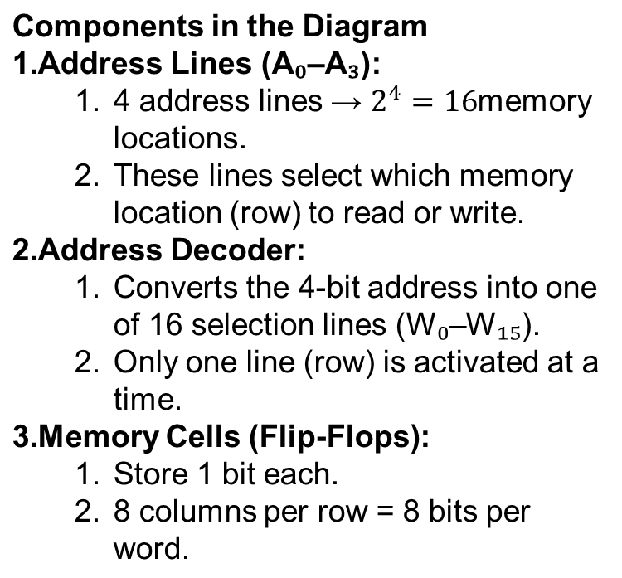
Memory Chip Basics
16 × 8 memory chip →
  16 = number of memory locations (rows)
  8 = number of bits stored in each location (columns)
So each row can hold 1 byte (8 bits) of data.
Sense/Write Circuit:
Used for both reading and writing data.
Connected to bit lines (b₀–b₇).
Control Signals:
R/ W̅ → Read or Write control
  1 = Read
  0 = Write
CS → Chip Select (activates the chip)

Slide 15
Read Operation
R/ W̅ = 1 (Read mode)
The address decoder activates one word line (say W₅).
The data (8 bits) stored in that row appear on the bit lines (b₇–b₀).
The Sense circuits detect and output those bits to the data bus.
Data flows from memory → output lines
Write Operation
R/ W̅ = 0 (Write mode)
The address decoder selects one word line.
Data from input lines (b₇–b₀) go through the Write circuits into the selected memory cells (flip-flops).
Old data is overwritten by new data.
Data flows from input lines → memory

Slide 16
Operation | Control (R/ W̅) | Data Flow Direction | Function
Read | 1 (High) | Memory → Output | Retrieve stored data
Write | 0 (Low) | Input → Memory | Store new data

Slide 17
Internal organization of memory chips (Contd.,)
The memory circuit stores 128 bits and requires 14 external connections for address, data, and control lines. It also needs two lines for power supply and ground connections. Consider now a slightly larger memory circuit, one that has 1K (1024) memory cells. This circuit can be organized as a 128 × 8 memory, requiring a total of 19 external connections. Alternatively, the same number of cells can be organized into a 1K×1 format. In this case, a 10-bit address is needed, but there is only one data line, resulting in 15 external connections

Slide 18
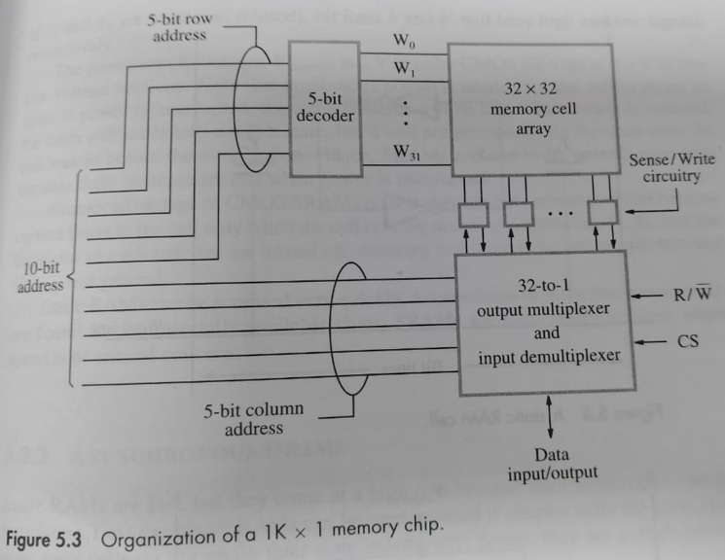
Organization of 1K x 1 memory chip

Slide 19
In 1K bit memory chip(128x8), we have 128 words(rows) & 8 columns
For 128 words, we need 7 address lines
8 columns means 8 data lines
2 control lines and 2 power supply lines
Totally we need 19 external connections
So, to reduce the number of connections, we go for alternative arrangement in which 1K(1024) cells are arranged as 1Kx 1 format which requires 15 connections
10 bit address is divided into 2 groups of 5 bits each to form the row & column addresses for the cell array.
A row address selects a row of 32 cells, all accessed in parallel. But, according to the column address, only one of these cells is connected to the external data line by the output multiplexer & input demultiplexer.

Slide 20
The Memory System
Read-Only Memories (ROMs)

Slide 21
Read-Only Memories (ROMs)
SRAM and SDRAM chips are volatile:
  Lose the contents when the power is turned off.
User always wants to store data permanently. So, we need non-volatile memory
ROM is an non volatile memory
Many applications need memory devices to retain contents after the power is turned off.
  For example, in typical computer system, hard disk is used to store large amount of information including OS, system software's, etc.
  When a computer is turned on, the OS has to be loaded from the disk into the main memory.
  To load OS from hard disk to main memory, separate program called “boot” program has to be used, which is stored in hard disk.

Slide 22
Read-Only Memories (ROMs)
Generally, non-volatile memory is normally used for only reading operation, hence they are called Read Only Memory (ROM).
To store information in ROM, special writing process is needed.

Slide 23
Read-Only Memories (Contd.,)
Read-Only Memory:
  Data are written into a ROM when it is manufactured.
Programmable Read-Only Memory (PROM):
  In PROM, user can write the data into the PROM only once
  Process of inserting the data is irreversible.
  Storing information specific to a user in a ROM is expensive.
  PROM chips are available with all its contents ‘0’. That means, initially it contains all 0’s
  User can insert 1’s at the required locations by burning out the fuses at these locations using current pulses.
  Providing programming capability to a user may be better.

Slide 24
EPROM
Erasable Programmable Read-Only Memory (EPROM):
  In PROM’s, once the data is programmed(written), that cannot be changes
  PROM’s which allow user to erase the stored data & allows to load new data is referred as EPROM
  This Flexibility is useful during the development phase of digital systems.
  Since, EPROM’s are capable of retaining stored data for longer period of time & also to erase & program, these EPROM’s can be used in place of ROM’s. In this way, memory changes & updates can be easily made.
  Here, data can be erased by passing ultraviolet (UV) rays & changes can be done by burning the required fuses as we did in PROM’s.
  Here, in order to erase, we need to remove the EPROM chip from the board.
  Erasable, reprogrammable ROM.

Slide 25
EEPROM
Another version of EPROM allows programming & erasing electrically.
Such chips are known as EEPROM
Here, no need to remove the EEPROM chip from the board for erasing
Disadvantage is that, we need different voltages to erase, write & read the stored data.
Another disadvantage is that, each byte has to be erased separately.

Slide 26
Read-Only Memories (Contd.,)
Flash memory: Used in USBs, SSDs, memory cards
  Structure of flash memory is similar to EEPROM.
  It is possible to Read the contents of a single cell, but not possible to write single cell.
  Here, we need to write entire block of cells at a time.
  It requires single supply voltage for read, write & erase.
  Flash devices have greater density.
    Higher capacity and low storage cost per bit.
  Power consumption of flash memory is very low, making it attractive for use in equipment that is battery-driven.
  Single flash chips are not sufficiently large, so
  larger memory modules are implemented using
  flash cards and flash drives.

Slide 27
Speed, Size, and Cost
A big challenge in the design of a computer system is to provide a sufficiently large memory, with a reasonable speed at an affordable cost.
Static RAM:
  Very fast, but expensive, because a basic SRAM cell has a complex circuit making it impossible to pack a large number of cells onto a single chip. Used in Cache
Dynamic RAM:
  Simpler basic cell circuit, hence are much less expensive, but significantly slower than SRAMs. Used in Main Memory
Magnetic disks:
  Storage provided by DRAMs is higher than SRAMs, but is still less than what is necessary.
  Secondary storage such as magnetic disks provide a large amount
  of storage, but is much slower than DRAMs.

Slide 28
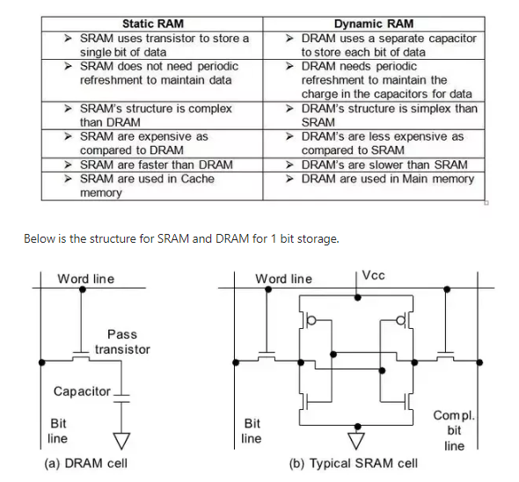
SRAM vs DRAM

Slide 29
Memory Hierarchy
Pr
ocessor
Fastest access is to the data held in
processor registers. Registers are at
the top of the memory hierarchy.
Relatively small amount of memory that
can be implemented on the processor
chip. This is processor cache.
Two levels of cache. Level 1 (L1) cache
is on the processor chip. Level 2 (L2)
cache is in between main memory and
processor.
Next level is main memory, implemented
as SIMMs. Much larger, but much slower
than cache memory.
Next level is magnetic disks. Huge amount
of inexepensive storage.
Speed of memory access is critical, the
idea is to bring instructions and data
that will be used in the near future as
close to the processor as possible.
Re
gisters
Increasing
Increasing
Increasing
size
speed
cost per bit
Primary
L1
cache
Secondary
L2
cache
Main
memory
Magnetic disk
secondary
memory

Slide 30
The Memory System
Cache Memories

Slide 31
Cache Memories
Processor is much faster than the main memory.
  As a result, the processor has to spend much of its time waiting while instructions and data are being fetched from the main memory.
  Major obstacle towards achieving good performance.
Speed of the main memory cannot be increased beyond a certain point.
Cache memory is an architectural arrangement which makes the main memory appear faster to the processor than it really is.
Cache memory is based on the property of computer programs known as “locality of reference”.

Slide 32
Locality of Reference
Analysis of programs indicates that many instructions in localized areas of a program are executed repeatedly during some period of time, while the others are accessed relatively less frequently.
  These instructions may be the ones in a loop, nested loop or few procedures calling each other repeatedly.
  This is called “locality of reference”.
Temporal locality of reference:
  Recently executed instruction is likely to be executed again very soon.
Spatial locality of reference:
  Instructions with addresses close to a recently instruction are likely
  to be executed soon.

Slide 33
Cache memories
Word transfer
Fast
Block transfer
Slow
Processor
Cache
Main
memory
Processor issues a Read request, a block of words is transferred from the main memory to the cache, one word at a time.
Subsequent references to the data in this block of words are found in the cache.
At any given time, only some blocks in the main memory are held in the cache. Which blocks in the main memory are in the cache is determined by a “mapping function”.
When the cache is full, and a block of words needs to be transferred
from the main memory, some block of words in the cache must be
replaced. This is determined by a “replacement algorithm”.

Slide 34
Cache hit
Existence of a cache is transparent to the processor. The processor issues Read and Write requests in the same manner.
If the data is in the cache it is called a Read hit or Write HIT.
If the data is not present in the cache, then a Read miss or Write MISS occurs.

Slide 35
Mapping functions
Mapping functions determine how & where memory blocks are placed in the cache.
A simple processor example:
  Cache consisting of 128 blocks of 16 words each.
  Total size of cache is 2048 (2K) words.
  Main memory is addressable by a 16-bit address.
  Main memory has 64K words.
  Main memory has 4K blocks of 16 words each.
Three mapping functions:
  Direct mapping
  Associative mapping
  Set-associative mapping.

Slide 36
At any given time, only some blocks in the main memory are held in the cache. “mapping function” maps the cache memory and the main memory.
When the cache is full, “replacement algorithm”.
 | 0
 | 1
 | 2
 | 3
 | 4
 | 5
 | 6
 | ;
 | ;
 | ;
 | 1024
 | 0
 | 1
 | 2
 | 3
 | ;
 | ;
 | 9

Slide 37
Direct mapping
Cache Memory Main memory
Block j % cache_blocks
 | 0
 | 1
 | 2
 | 3
 | ;
 | ;
 | 9
 | 0
 | 1
 | 2
 | :
 | 9
 | 10
 | 11
 | ;
 | ;
 | ;
 | 1024

Slide 38
Direct mapping
Block j % cache_blocks
Main
Block 0
memory
Cache
Block 1
tag
Block 0
Tag 0
tag
Block 1
Block 127
Block 128
tag
Block 127
Block 129
Tag 1
T
ag
Block
W
ord
Block 255
5
7
4
Block 256
Main memory address
Block 257
Tag n
Block 4095
Notes:
Street, main road, house no

Slide 39
Tag no | Block no | word
t | m | k
If 2^{k} is the no. of words in a block, then k bits to represent a word.
If 2^{m} is the no. of blocks in cache memory, then m bits to represent a block.
No. of tags= (no. of main memory blocks) / (no. of cache blocks) = 2^{t}, then t bits to represent a tag.
OR
No. of tag bits = total address bits – (no. of bits for word + no. of bits for block)

Slide 40
Cache address
memory address
Tag no | Block no | word
5 | 7 | 4
Block no. | word
12 | 4
Block j of the main memory maps to j % 128 of the cache. 0 maps to 0, 129 maps to 1.
More than one memory block is mapped onto the same position in the cache, at different times.
Memory address is divided into three fields:
- Low order 4 bits determine one of the 16 words in a block.
- When a new block is brought into the cache, the next 7 bits determine which cache block this new block is placed in.
- High order 5 bits determine which of the possible 32 blocks is currently present in the cache. These are tag bits.
Simple to implement but not very flexible.

Slide 41
Consider a cache consisting of 256 blocks of 16 words each, for a total of 4096 words and assume main memory is addressable by 16 bit address and it consists of 4K blocks. How many bits are there in each of Tag, block/set and word fields for different mapping techniques?
Given: main memory – 16 bits address => memory is of 2¹⁶ words.
=> 2¹² blocks X 2⁴
B0 – 16 words | 0
B1 – 16 words | 1
: : : | : : :
B255 – 16 words | 255
Direct mapping –
No. of words = 16 = 2⁴ => 4 bits
No. of blocks = 256 = 2⁸ => 8 bits
No. of tag bits = 16 - (4+8) = 4
Tag no | Block no | word
t | m | k
Tag no | Block no | word
4 | 8 | 4
Notes:
No. of tags = (2¹²) / (2⁸) => 2⁴ OR No. of tag bits = 16 - (4+8) = 4

Slide 42
Consider a cache consisting of 64 blocks and main memory consisting of 4096 blocks of 128 words each. i) How many bits for memory address? ii) How many bits for representing tag, block and word fields?
Given: main memory – 4096 blocks of 128 words => 2¹² blocks X 2⁷ words. => 2¹⁹ words
i) Hence 19 bits to represent memory address.
B0 – 128 words | 0
B1 – 128 words | 1
: : : | : : :
B63 – 128 words | 63
Direct mapping –
No. of words = 128 = 2⁷ =>
No. of blocks =64 = 2⁶ =>
No. of tag bits = 19 – (7+6) = 6
Tag no | Block no | word
t | m | k
Tag no | Block no | word
6 | 6 | 7
Notes:
No. of tags = (2¹²) / (2⁶) => 2⁶ =>

Slide 43
A simple processor example:
  Cache consisting of 128 blocks of 16 words each.
  Total size of cache is 2048 (2K) words.
  Main memory is addressable by a 16-bit address.
  Main memory has 64K words.
  Main memory has 4K blocks of 16 words each.
Address Breakdown
Field | Bits | Description
Tag | 6 bits | Identifies which memory block is in cache
Cache Block | 6 bits | Points to one of the 64 cache blocks
Word | 4 bits | Selects one of 16 bytes within the block

Slide 44
1)Consider a cache consisting of 128 blocks of 4 words each and main memory consisting of 4096 blocks. i) How many bits for memory address? ii) How many bits for representing tag, block and word fields?
2) A computer system has a main memory of 16K blocks of 4 words each and has a 512 words cache. How many bits are required for tag, block / set and word fields in each mapping techniques ( In set- associative, 4 blocks per set).
3) Consider a cache memory of 16 words. Each block consists of 4 words. Size of the main memory is 256 bytes. How many bits for representing tag, block and word fields?

Slide 45
Associative mapping
Block j placed in any free space of cache
Main
Block 0
memory
Cache
Block 1
tag
Block 0
tag
Block 1
Block 127
Block 128
tag
Block 127
Block 129
Tag
Word
Block 255
12
4
Block 256
Main memory address
Block 257
Block 4095

Slide 46
Tag no | word
t | k
Main memory block can be placed into any cache position.
Memory address is divided into two fields:
Low order 4 bits identify the word within a block.
High order 12 bits or tag bits identify a memory block when it is resident in the cache. (total address bits – word bit)
Flexible, and uses cache space efficiently.
Replacement algorithms can be used to replace an existing block in the cache when the cache is full.
Cost is higher than direct-mapped cache because of the need to search all 128 patterns to determine whether a given block is in the cache.

Slide 47
Consider a cache consisting of 256 blocks of 16 words each, for a total of 4096 words and assume main memory is addressable by 16 bit address and it consists of 4K blocks. How many bits are there in each of Tag, block/set and word fields for different mapping techniques?
Given: main memory – 16 bits address => memory is of 2¹⁶ words.
=> 2¹² blocks X 2⁴ words.
B0 – 16 words | 0
B1 – 16 words | 1
: : : | : : :
B255 – 16 words | 255
Associative mapping –
No. of words = 16 = 2⁴ =>
No. of tag bits = total address bits – word bits=> 16-4 =>12
Tag no | word
t | k
Tag no | word
12 | 4

Slide 48
Set-Associative mapping
Cache
Main
memory
Block 0
tag
Block 0
Block 1
tag
Block 1
Block j % Cache_set
Any position in a specific set.
tag
Block 2
tag
Block 3
Block 63
Block 64
tag
Block 126
Block 65
tag
Block 127
T
ag
Set / block
W
ord
Block 127
6
6
4
Block 128
Main memory address
Block 129
Block 4095

Slide 49
Tag no | set | word
t | s | k
Blocks of cache are grouped into sets.
Mapping function allows a block of the main memory to reside in any block of a specific set.
Divide the cache into 64 sets, with two blocks per set.
Memory block 0, 64, 128 etc. map to block 0, and they can occupy either of the two positions.
Memory address is divided into three fields:
- 6 bit field determines the set number.
- High order 6 bit fields are compared to the tag fields of the two blocks in a set.
No. of sets in cache = (total no. of blocks) / (no. of blocks in a set)
No. of tags= (no. of main memory blocks) / (no. of sets in cache) = 2^{t}, then t bits to represent a tag.
Set-associative mapping combination of direct and associative mapping.
Number of blocks per set is a design parameter.
- One extreme is to have all the blocks in one set, requiring no set bits (fully associative mapping).
- Other extreme is to have one block per set, is the same as direct mapping.

Slide 50
Consider a cache consisting of 256 blocks of 16 words each, for a total of 4096 words and assume main memory is addressable by 16 bit address and it consists of 4K blocks. How many bits are there in each of Tag, block/set and word fields for different mapping techniques?
Given: main memory – 16 bits address => memory is of 2¹⁶ words.
=> 2¹² blocks X 2⁴ words.
B0 – 16 words | 0
B1 – 16 words | 1
: : : | : : :
B255 – 16 words | 255
Set – Associative mapping -> ( Assume that, there are 2 cache blocks in each set.)
No. of words = 16 = 2⁴ =>
No. of sets = 256/2 = 2⁷ =>
No. of tags = (2¹²) / (2⁷) => 2⁵ =>
Tag no | set | word
t | s | k
Tag no | Set | word
5 | 7 | 4

Slide 51
Direct mapping –
Associative mapping –
Set – Associative mapping
Tag no | Block no | word
t | m | k
Tag no | word
t | k
Tag no | set | word
t | s | k

Slide 52
Suppose main memory consists of 32 blocks of 4 words each and cache consists of 4 blocks. How many bits required for main memory address? How many bits are there in each of Tag, block/set and word fields for different mapping techniques?

Slide 53
Suppose main memory consists of 32 blocks of 4 words each and cache consists of 4 blocks. How many bits required for main memory address? How many bits are there in each of Tag, block/set and word fields for different mapping techniques?
Given: main memory – 32 blocks of 4 words each=> 2⁵ blocks X 2² words.
=> 2⁷ words
=> memory address is 7 bits
B0 – 4 words | 0
B1 – 4 words | 1
B2 – 4 words | 2
B3 – 4 words | 3
B0 – 4 words | 0
B1 – 4 words | 1
: : : | : : :
B31 – 4 words | 31
Cache memory
Main memory
1) Direct mapping –
No. of words = 4 = 2² =>
No. of blocks =4 = 2² =>
No. of tags = 7 – (2+2) = 3
Tag no | Block no | word
t | m | k
Tag no | Block no | word
3 | 2 | 2

Slide 54
2) Associative mapping –
No. of words = 4 = 2² =>
No. of tag bits = total bits – word bits=> 7-2 =5
Tag no | word
t | k
Tag no | word
5 | 2
3) Set – Associative mapping -> ( Assume that, there are 2 cache blocks in each set.)
No. of words = 4 = 2² =>
No. of sets = 4/2 = 2¹ =>
No. of tags = 7-(2+1) = 4
Tag no | set | word
t | s | k
Tag no | Set | word
4 | 1 | 2

Slide 55
Cache Mapping-
Cache mapping defines how a block from the main memory is mapped to the cache memory in case of a cache miss.
OR
Cache mapping is a technique by which the contents of main memory are brought into the cache memory.

Slide 56
Main memory is divided into equal size partitions called as blocks
Cache memory is divided into partitions having same size as that of blocks called as lines.
During cache mapping, block of main memory is simply copied to the cache and the block is not actually brought from the main memory.

Slide 57
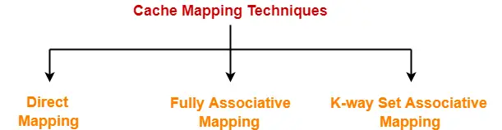

Slide 58
1. Direct Mapping-
A particular block of main memory can map only to a particular line of the cache.
The line number of cache to which a particular block can map is given by-
Cache line number
= ( Main Memory Block Address ) Modulo (Number of lines in Cache)

Slide 59
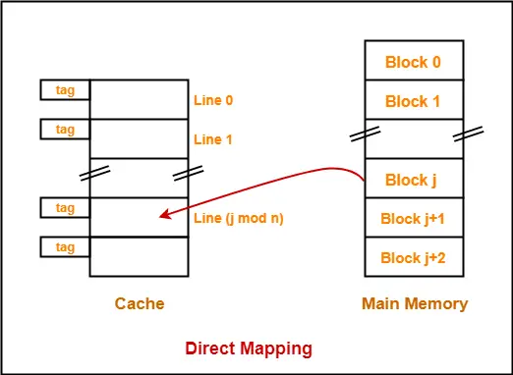
Example-
Consider cache memory is divided into ‘n’ number of lines.
Then, block ‘j’ of main memory can map to line number (j mod n) only of the cache.

Slide 60
In direct mapping, the physical address is divided as-
Tag no | Block no | word
t | m | k
If 2^{k} is the no. of words in a block, then k bits to represent a word.
If 2^{m} is the no. of blocks in cache memory, then m bits to represent a block.
No. of tags= (no. of main memory blocks) / (no. of cache blocks) = 2^{t}, then t bits to represent a tag.
OR
No. of tag bits = total address bits – (no. of bits for word + no. of bits for block)

Slide 61
Cache address
memory address
Tag no | Block no | word
5 | 7 | 4
Block no. | word
12 | 4
Block j of the main memory maps to j % 128 of the cache. 0 maps to 0, 129 maps to 1.
Memory address is divided into three fields:
- Low order 4 bits determine one of the 16 words in a block.
- When a new block is brought into the cache, the next 7 bits determine which cache block this new block is placed in.
- High order 5 bits determine which of the possible 32 blocks is currently present in the cache. These are tag bits.
Simple to implement but not very flexible.

Slide 62
Consider a cache consisting of 256 blocks of 16 words each, for a total of 4096 words and assume main memory is addressable by 16 bit address and it consists of 4K blocks. How many bits are there in each of Tag, block/set and word fields for different mapping techniques?
Given: main memory – 16 bits address => memory is of 2¹⁶ words.
=> 2¹² blocks X 2⁴ words.
B0 – 16 words | 0
B1 – 16 words | 1
: : : | : : :
B255 – 16 words | 255
Direct mapping –
No. of words = 16 = 2⁴ => 4 bits
No. of blocks = 256 = 2⁸ => 8 bits
No. of tag bits = 16 - (4+8) = 4
Tag no | Block no | word
t | m | k
Tag no | Block no | word
4 | 8 | 4
Notes:
No. of tags = (2¹²) / (2⁸) => 2⁴ OR No. of tag bits = 16 - (4+8) = 4

Slide 63
Consider a cache consisting of 64 blocks and main memory consisting of 4096 blocks of 128 words each. i) How many bits for memory address? ii) How many bits for representing tag, block and word fields?
Given: main memory – 4096 blocks of 128 words => 2¹² blocks X 2⁷ words. => 2¹⁹ words
i) Hence 19 bits to represent memory address.
B0 – 128 words | 0
B1 – 128 words | 1
: : : | : : :
B63 – 128 words | 63
Direct mapping –
No. of words = 128 = 2⁷ =>
No. of blocks =64 = 2⁶ =>
No. of tag bits = 19 – (7+6) = 6
Tag no | Block no | word
t | m | k
Tag no | Block no | word
6 | 6 | 7
Notes:
No. of tags = (2¹²) / (2⁶) => 2⁶ =>

Slide 64
1)Consider a cache consisting of 128 blocks of 4 words each and main memory consisting of 4096 blocks. i) How many bits for memory address? ii) How many bits for representing tag, block and word fields?
2) A computer system has a main memory of 16K blocks of 4 words each and has a 512 words cache. How many bits are required for tag, block / set and word fields in each mapping techniques ( In set- associative, 4 blocks per set).

Slide 65
Consider a cache consisting of 64 blocks and main memory consisting of 4096 blocks of 128 words each.
How many bits for memory address?
ii) How many bits for representing tag, block and word fields?

Slide 66
Fully Associative Mapping-
In fully associative mapping,
A block of main memory can map to any line of the cache that is freely available at that moment.
This makes fully associative mapping more flexible than direct mapping.

Slide 67
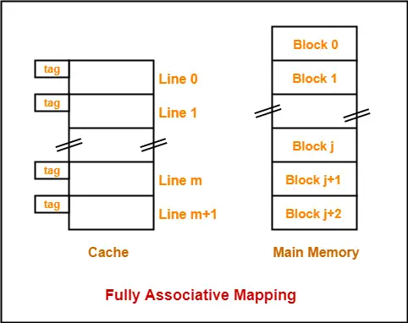
All the lines of cache are freely available.
Thus, any block of main memory can map to any line of the cache.
Had all the cache lines been occupied, then one of the existing blocks will have to be replaced.

Slide 68
K-way Set Associative Mapping-
Cache lines are grouped into sets where each set contains k number of lines.
A particular block of main memory can map to only one particular set of the cache.
However, within that set, the memory block can map any cache line that is freely available.
The set of the cache to which a particular block of the main memory can map is given by-
Cache set number
= ( Main Memory Block Address ) Modulo (Number of sets in Cache)

Slide 69
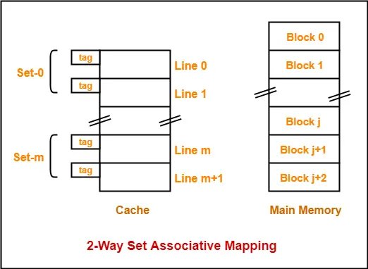
k = 2 suggests that each set contains two cache lines.
Since cache contains 6 lines, so number of sets in the cache = 6 / 2 = 3 sets.
Block ‘j’ of main memory can map to set number (j mod 3) only of the cache.
Within that set, block ‘j’ can map to any cache line that is freely available at that moment.
If all the cache lines are occupied, then one of the existing blocks will have to be replaced.

Slide 70
END of Module 2 Part B: Memory

